Slide 1

LEAVE MANAGEMENT SYSTEM TEAM MEMBERS :- 1)V.VEERANJINEYULU -1901211. 2)M.BHARADWAJ RATHOD -1901108. 3)N.MANI MOKSHITH -1901124. 4)M.HARIKRISHNA-1901110.

Slide 2

OVERVIEW : -
This project is aimed at developing an online leave management system that is of importance to an organization. The Leave Management System (LMS) is a web based application that can be accessed throughout the organization or a specified staff/Dept. System can be accessed to automate the workflow of leave applications and their approvals.Periodic crediting of leave is also automated. These contain features like email notifications, cancellation of leave, automatic approval of leave in this system.
The online Leave Management System is designed to run on the organization’s server and to allow employees to apply based on their leave balance, revoke leave application, and cancel leave. Consequently, the Admin & HOD should be able to review the contents of the leave application and approve or reject the applications.

Slide 3
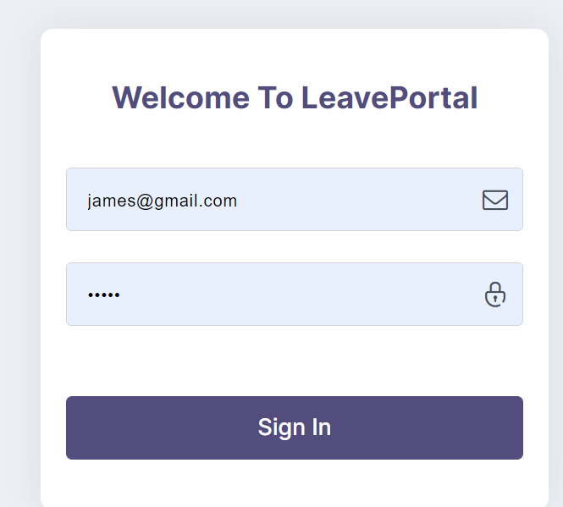
Login
HOD
Staff
Admin
All the above mentioned people can login through this portal.
After login page is accessed / logged in.
He / She can be directed to respective home pages.

Slide 4
Staff can apply for the leave by giving the details of himself/herself.
Details includes
First Name
Last Name
Email address
Available leave days
Leave type
Start leave date
End Leave Date
Reason for leave
Department
User role(staff, HOD, Admin)

Slide 5
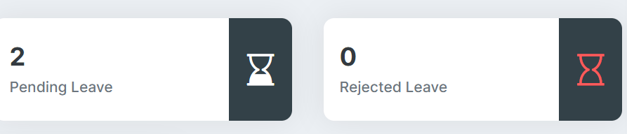
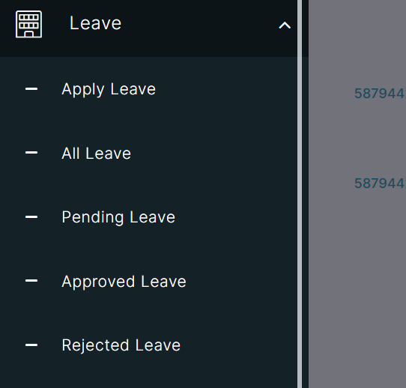
Leave Applications and Staff details
Admin and HOD can be able to notice the details of staff and leave applications.
They can also notice how many leave applications are accepted, rejected, pending.
Admin can add the leaves for festivals and vacations too.

Slide 6
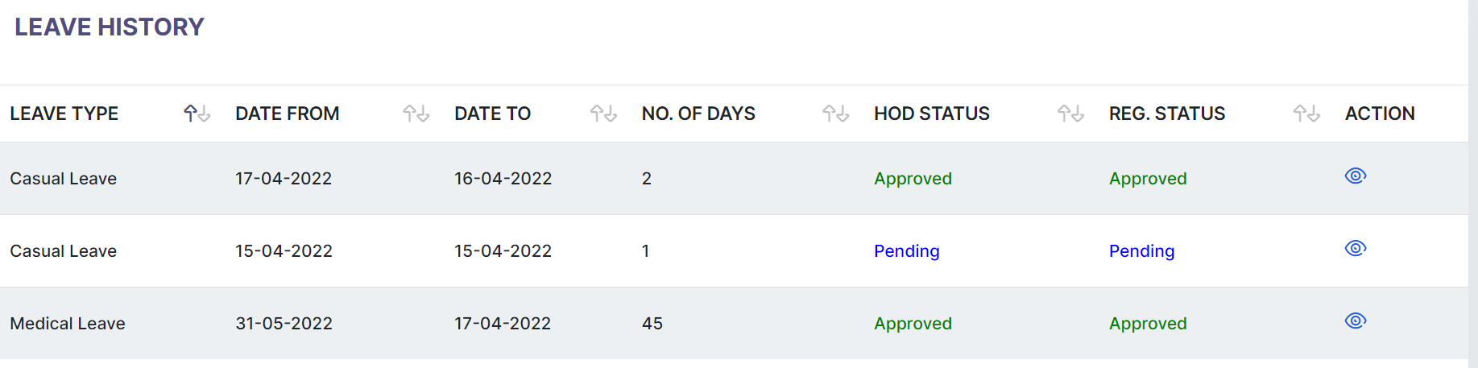
Staff can see his/her Leave history he or she join the company or college.

Slide 7
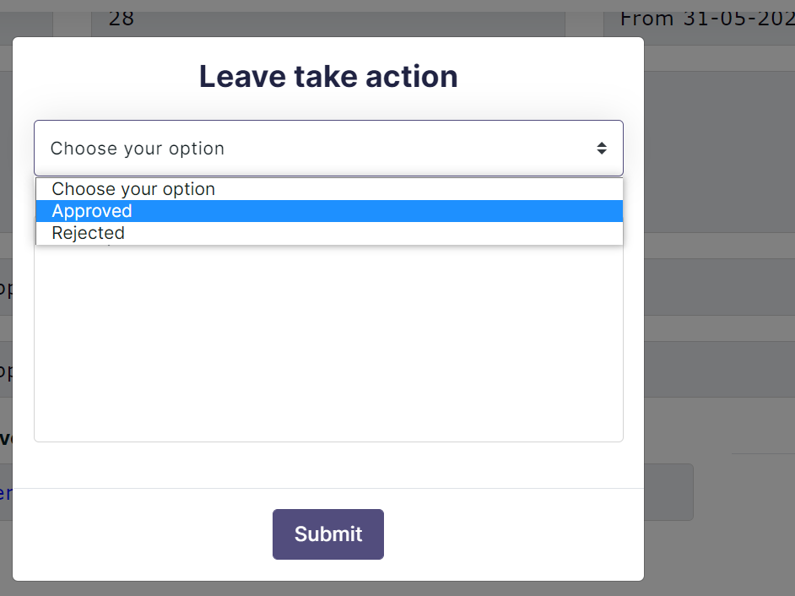
In Order to approve the leave application of a staff it must be approved by HOD and the Admin.
Admin and HOD can approve/Reject the leave applications.

Slide 8
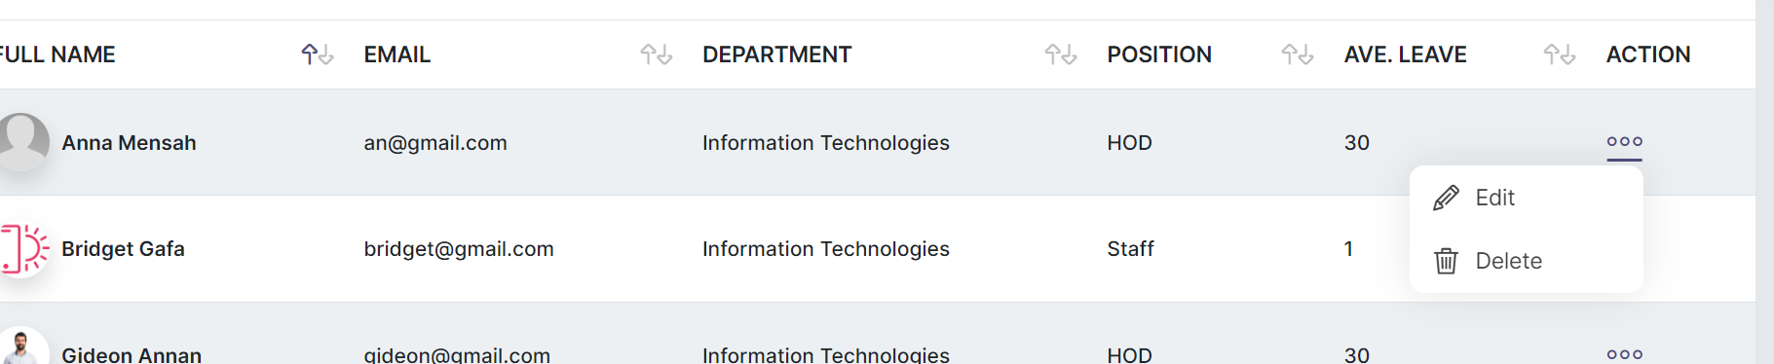
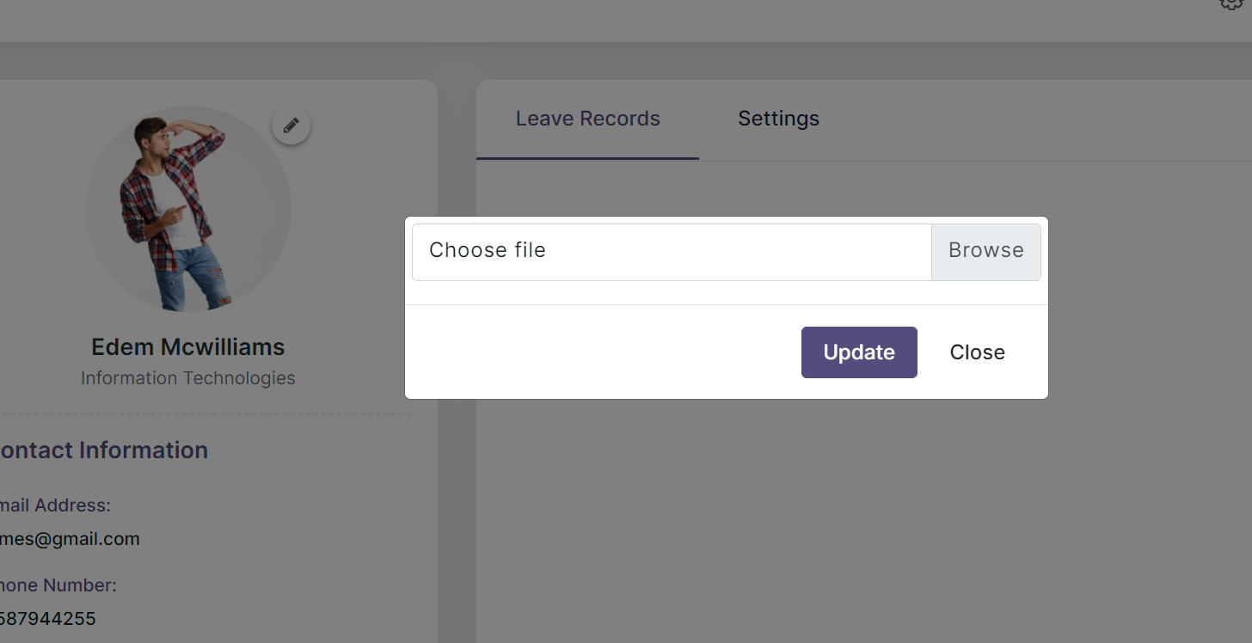
Admin can add staff/Remove the staff.
A user (HOD/Admin/staff) can update their profile.

